Slide 1

UE23CS320A – Capstone Project Approval
Project Title : Detecting Depression using vocal cues
Project ID : PW26_CBH_04
Project Guide : MS. Chandravva Hebbi
Project Team : Vishruth Rallapalli
Yuvraj Rao
Vivan Jeevan Naik
Srujan Kumar J

Slide 2
Detecting Depression using vocal cues
Outline
Problem Statement
Introduction
Research Gaps and Novelty
Objectives
Scope and Feasibility study
Challenges
Literature Survey
Applications/Use cases
Future Enhancements
Data Requirement
Project Timeline
References

Slide 3
Detecting Depression using vocal cues
Problem Statement
Depression is a growing global mental health concern.
Diagnosis primarily relies on self-reporting and clinical interviews.
Due to social stigma and denial, individuals often hide symptoms.
Need for objective, technology-driven detection systems that analyze behavior.
Voice-based detection provides a non-intrusive and natural way to assess emotional state.

Slide 4
Detecting Depression using vocal cues
Introduction
  Understanding Depression & the Need for Automation:
  Depression is a global mental health concern, affecting over 280 million people (WHO, 2023).
  Traditional diagnosis relies on self-report questionnaires (e.g., BDI-II, PHQ-9) and clinical interviews.
  These methods are subjective, time-consuming, and affected by social stigma – people may hide or underreport symptoms.
  There is a growing need for objective, technology-driven tools for early detection.
  Speech and voice contain rich emotional and cognitive cues — offering a non-invasive and continuous monitoring method.

Slide 5
Detecting Depression using vocal cues
Introduction
  How Vocal Cues Reveal Depression:
  Depression affects speech prosody, pitch, energy, and rhythm (prosodic features).
  Common indicators: Reduced pitch variability → monotonous tone.
  Lower speech rate → slowed cognitive processing.
  Longer pauses / silence ratio → hesitation or fatigue.
  Low energy & intensity → emotional flatness.
  Models analyze acoustic features (e.g., MFCCs, F0, jitter, shimmer) and linguistic content to detect signs.

Slide 6
Detecting Depression using vocal cues
Introduction
  How Vocal Cues Reveal Depression:
  ML systems learn patterns distinguishing sadness, fatigue, and true depression using multimodal data (vocal + visual cues).
  Challenge: differentiating between temporary sadness and clinical depression — requires sustained patterns over time

Slide 7
Detecting Depression using vocal cues
Research Gaps and Novelty
Research Gaps:
Existing models mainly monolingual (English datasets like AVEC, DAIC-WOZ).
Lack of multilingual and regional speech datasets (e.g., Indian languages).
Limited real-world conversational data — mostly lab recordings.
Few systems incorporate both vocal and visual modalities together.
Emotional overlaps (sadness vs depression) often misclassified.

Slide 8
Detecting Depression using vocal cues
Research Gaps and Novelty
Novelty:
Multilingual Depression Detection: Expands beyond English to include regional languages for wider applicability.
Bias-Reduced Dataset: Focuses on collecting balanced, unbiased local data across age, gender, and accent.
Context-Aware Vocal Analysis: Differentiates between temporary sadness and sustained depressive speech patterns.
Explainable ML Model: Provides interpretable results highlighting key vocal cues linked to depression.

Slide 9
Detecting Depression using vocal cues
Objectives
Build an ML model that detects depression using vocal prosody features.
Extend to multilingual datasets (e.g., English–Kannada/other Indian languages).
Integrate facial (AAM) features for multimodal prediction.
Compare mono-modal vs multimodal accuracy.
Develop an early-screening tool for clinical and educational environments.

Slide 10
Detecting Depression using vocal cues
Scope and Feasibility study
Scope:
Extend analysis to multilingual speech for broader cultural and linguistic coverage.
Incorporate visual AAM (Active Appearance Model) features in the future for multimodal predictions.
Enable non-invasive, continuous mental health monitoring using simple audio recordings.
Create a research-ready dataset of regional voices labeled with depression levels.
Support clinicians, psychologists, and educational institutions with AI-assisted early detection tools.

Slide 11
Detecting Depression using vocal cues
Scope and Feasibility study
Feasibility:
Prior studies (e.g., MIT Lincoln Lab, AVEC 2016) have shown 70–80% accuracy using monolingual vocal data.
Our project builds upon this foundation by adding multilingual and contextual layers.
Implementation is feasible using open-source frameworks (TensorFlow, PyTorch, OpenSMILE).
Requires regional voice dataset collection, which is the main challenge for model training.

Slide 12
Detecting Depression using vocal cues
Scope and Feasibility study
Feasibility:
Hardware needs are minimal — standard microphones and basic processing units are sufficient.
Based on the novelty, data collection and labeling form the major time component.
Feasible for academic setup with potential for real-world clinical trials later.

Slide 13
Detecting Depression using vocal cues
Challenges
Collecting unbiased and balanced data (gender, accent, age).
Differentiating depression vs temporary emotion.
Handling noisy real-world audio and background interference.
Ethical challenges — privacy & consent in mental health data.
Need for large, labeled multilingual datasets.
Synchronizing audio and video modalities for multimodal analysis.

Slide 14
Detecting Depression using vocal cues
Literature Survey
Study 1: Detecting Depression from Facial Actions & Vocal Prosody (Cohn et al., CMU)
Data: 57 diagnosed patients in clinical interviews.
Methods:
    Facial Action Coding System (FACS) – manual & automated AAM.
    Vocal Prosody Analysis – pitch, response latency.
    Classifier: Support Vector Machine (SVM).
Accuracy:
    FACS (manual): 88%
    AAM (automated): 79%
    Vocal Prosody: 79%
Gap: Only English data, no multilingual testing, and limited dataset size.

Slide 15
Detecting Depression using vocal cues
Literature Survey
Study 2: Detecting Depression Using Vocal, Facial & Semantic Cues (MIT Lincoln Lab)
Dataset: AVEC 2013, labeled using BDI-II (Beck Depression Inventory).
Features:
    Audio: Pitch, loudness, spectral features (OpenSMILE).
    Visual: Head/eye/mouth movement (Facial landmarks).
    Text: Word choice analysis (LIWC).
Model: Support Vector Regression (SVR).
Results:
    Audio: 0.58 correlation
    Visual: 0.52
    Text: 0.46
Multimodal fusion: 0.65+ correlation
Gap: Monolingual data, small dataset, limited real-world application.

Slide 16
Detecting Depression using vocal cues
Literature Survey
Study 3: Detecting Depression Severity from Vocal Prosody Yang, Fairbairn & Cohn (IEEE TAC, 2013) – Univ. of Pittsburgh
Studied 57 patients across treatment sessions using vocal prosody (pitch, tone, timing).
Prosody explained ~60% variance in depression scores, 69% accuracy achieved.
Switching pauses better indicators than pitch.
Interviewer’s tone also varied with patient mood.
Gaps: Only English, clinical data, no multimodal or multilingual features.

Slide 17
Detecting Depression using vocal cues
Literature Survey
Study 4: AI-Enhanced Emotional Assessment Suryawanshi et al., IJIRT (2024)
Used facial + vocal cues to detect depression.
CNN for facial emotions, Naive Bayes + NLP for speech tone & sentiment.
Combined model improved F1-score by 6–9%.
Found low expressivity & weak speech energy in depressed subjects.
Gaps: No regional or multilingual dataset; limited multimodal sync.

Slide 18
Detecting Depression using vocal cues
Literature Survey
Insights from Literature:
Vocal tone is a reliable depression marker.
Facial cues enhance accuracy when combined with speech.
Multimodal fusion outperforms single-modality systems.
Current systems lack regional adaptability and cross-language robustness.
Need to explore transfer learning with multilingual emotional data.

Slide 19
Detecting Depression using vocal cues
Applications/Use cases
Clinical Diagnosis: Assist psychiatrists in early depression screening.
Tele-health Platforms: Integrate into virtual consultations for remote monitoring.
Mental Health Apps: Used in mobile apps for self-assessment and daily mood tracking.
Hospitals & Counseling Centers: Support patient progress tracking through voice data.
Educational Institutions: Identify students under stress or emotional distress.
Corporate Wellness Programs: Monitor employee well-being during feedback or calls.

Slide 20
Detecting Depression using vocal cues
Applications/Use cases
Public Health Surveys: Large-scale depression trend analysis in regions.
Social Media Monitoring: Detect emotional decline through posted audio or video.
Smart Devices & Wearables: Voice-based emotion tracking in smartwatches/assistants.
Call Centers: Identify burnout or fatigue in customer support agents.
Rehabilitation Centers: Track improvement in therapy or addiction recovery.
Research Institutions: Benchmark data for emotion recognition and AI ethics studies.

Slide 21
Detecting Depression using vocal cues
Next Phase Developments
Add Facial Analysis (AAM) and Language-based sentiment for multimodal prediction.
Collect multilingual depression datasets (recordings in Indian languages).
Datasets needed:
    Existing: AVEC, DAIC-WOZ, E-DAIC (English).
    To Collect: Regional speech + emotional tone data (Kannada, Tamil, Hindi).
Incorporate deep transfer learning (Whisper, WavLM).
Develop real-time application using Gradio or Streamlit for testing.

Slide 22
Detecting Depression using vocal cues
Data Requirements
Existing Data Sources:
    DAIC-WOZ Dataset – Clinical interviews with audio, video, and transcripts for depression detection.
    AVEC (Audio/Visual Emotion Challenge) Dataset – Contains emotional and depression-level recordings.
    RAVDESS & CREMA-D – Emotional speech datasets for vocal prosody training.
    Kaggle FER Dataset – Facial emotion recognition dataset for multimodal integration.

Slide 23
Detecting Depression using vocal cues
Data Requirements
Additional Data Needed:
    Regional & Multilingual Speech Samples (Kannada, Hindi, English mix).
    Locally Recorded Conversations from students, clinical volunteers, and general speakers.
    Unscripted Real-Life Audio for unbiased vocal emotion modeling.

Slide 24
Detecting Depression using vocal cues
Data Requirements
Data Acquisition Plan:
    Collect consent-based recordings from participants within college/community.
    Use ethical approval & consent forms to ensure data privacy.
    Label depression levels using standard scales (BDI-II, PHQ-9).
    Combine with existing datasets to create a balanced multilingual corpus for model training.

Slide 25
Detecting Depression using vocal cues
Capstone (Phase-I & Phase-II) Project Timeline
Phase 1: Aug – Dec 2025
Conduct detailed literature review to identify research gaps and methodologies.
Define objectives, scope, and feasibility for multilingual depression detection.
Plan for dataset acquisition, including permissions and ethical considerations.
Begin data collection for vocal and facial features (preliminary dataset).
Data preprocessing and labeling: clean audio, extract vocal features, annotate facial expressions.
Initial ML model development using speech-based features.
Conduct preliminary evaluation to identify strengths and limitations.

Slide 26
Detecting Depression using vocal cues
Capstone (Phase-I & Phase-II) Project Timeline
Phase 2: Jan – May 2026
Integrate multimodal features: combine vocal cues with facial action units.
Model refinement: hyperparameter tuning, feature selection, improving accuracy.
Multilingual testing and validation to ensure regional adaptability.
Comprehensive result analysis: compare models, evaluate metrics, and optimize performance.
Prepare documentation and report for Phase 1 & 2 deliverables.

Slide 27
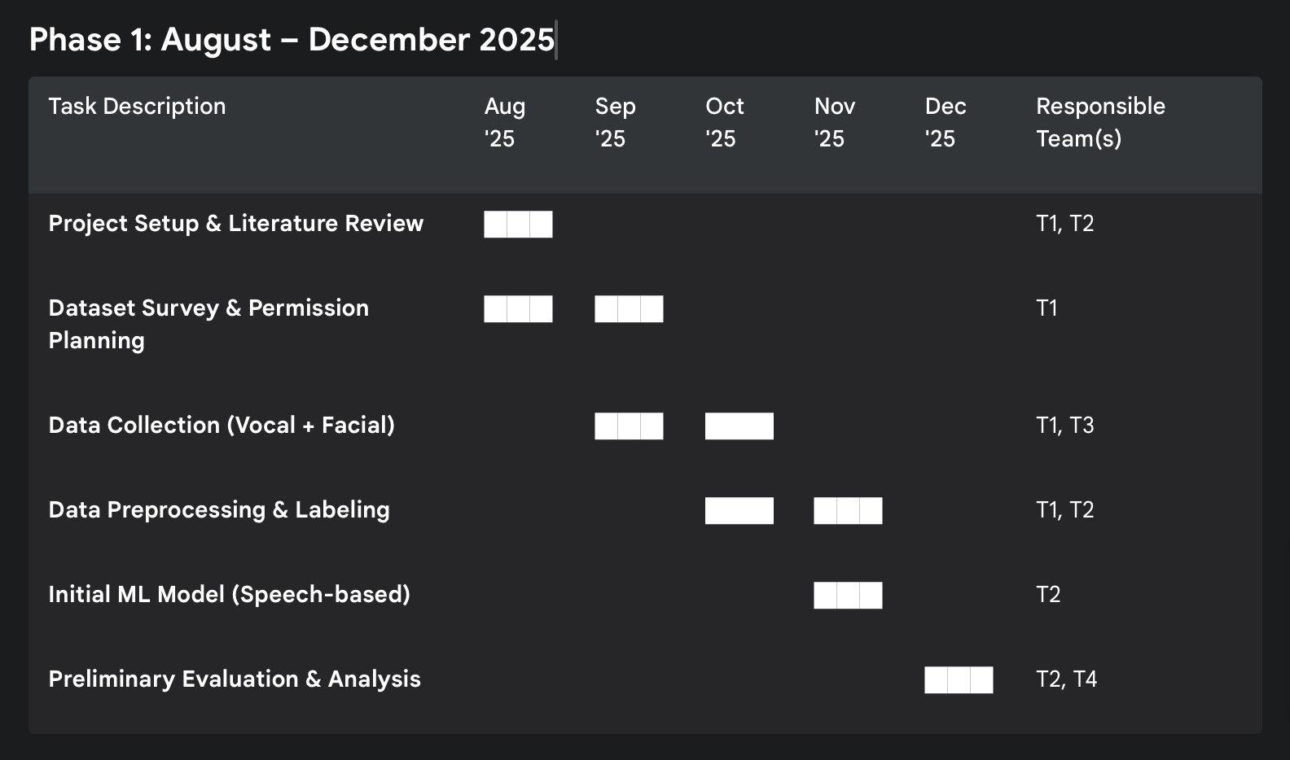
Detecting Depression using vocal cues
Capstone (Phase-I & Phase-II) Project Timeline

Slide 28
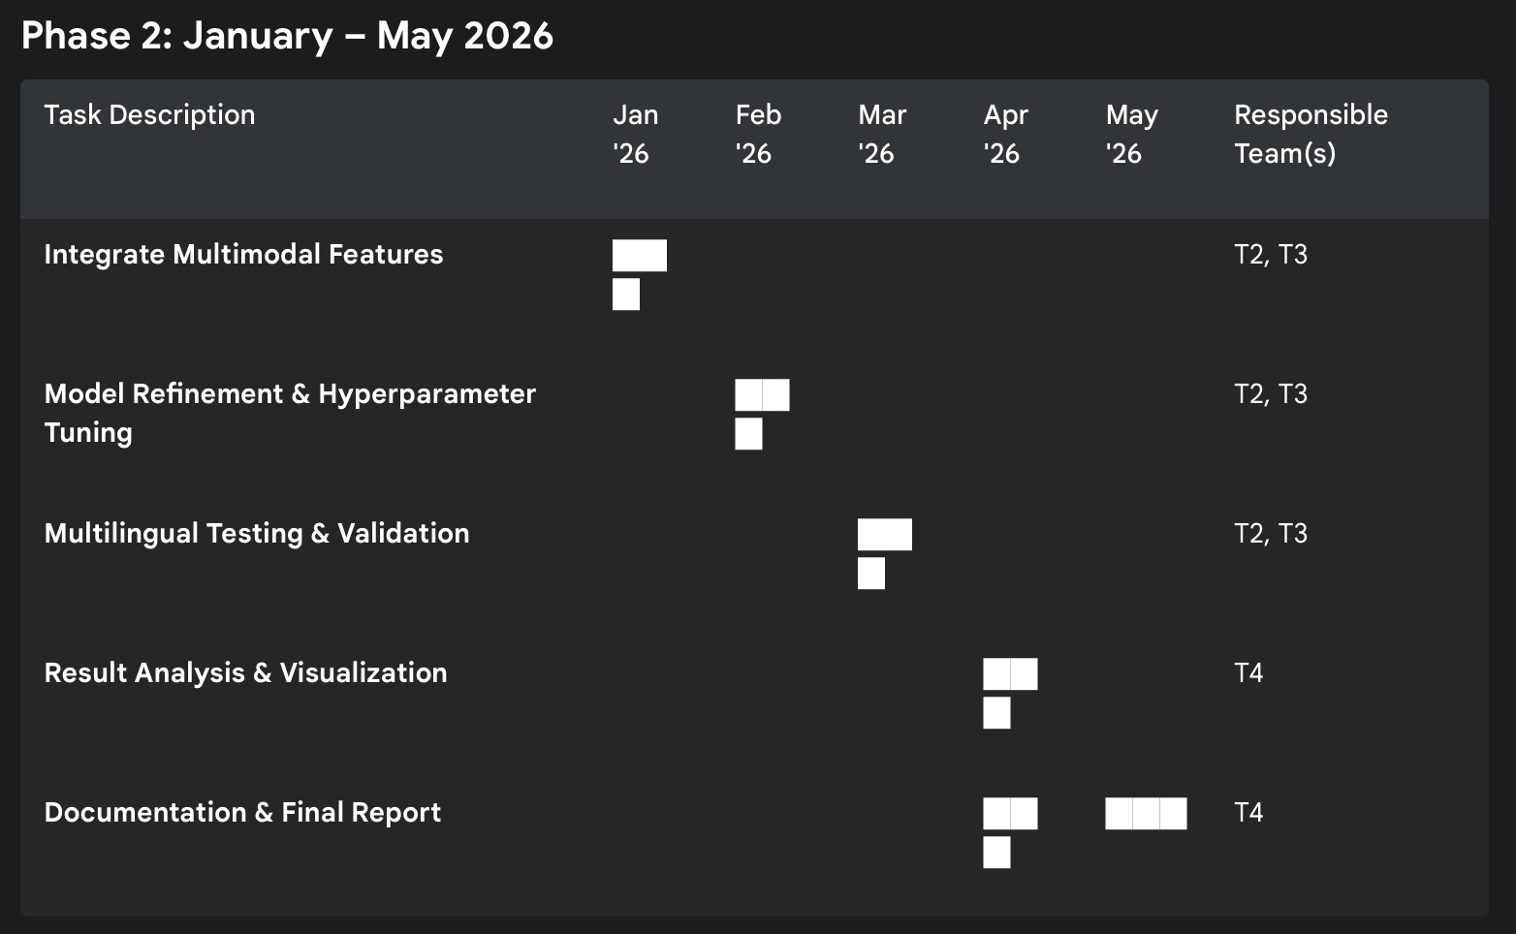
Detecting Depression using vocal cues
Capstone (Phase-I & Phase-II) Project Timeline

Slide 29
Detecting Depression using vocal cues
References
Ying Yang, Catherine Fairbairn, Jeffrey F. Cohn – Detecting Depression Severity from Vocal Prosody, 2013, University of Pittsburgh
Ms. Swati Suryawanshi, Mrs. Roomana Hasan, Mr. Kantilal Chandre – AI-Enhanced Emotional Assessment: Detecting Depression Levels through Visual and Vocal Expressions, 2024, IJIRT
Jeffrey M. Girard, Jeffrey F. Cohn, Mohammad H. Mahoor, Seyed Mohammad Mavadati, Dean P. Rosenwald – Social risk and depression: Evidence from manual and automatic facial expression analysis, 2013, IEEE & University of Pittsburgh
Cynthia Solomon, Michel F. Valstar, Richard K. Morriss, John Crowe – Automatic Emotional Facial Expression in Non-Psychotic Disorders: A Systematic Review and Meta-analysis, 2016, University of Nottingham

Slide 30
THANK YOU

